Slide 1

Bellabeat Case Study
A data analysis on fitbits

Slide 2
Agenda
Project Overview
Data
Findings
Recommendations

Slide 3
Project Overview
Analyze smart device data in order to create and recommend marketing strategies for the Bellabeat app and increase revenue.

Slide 4
Data
Fitbit data comes from https://www.kaggle.com/arashnic/fitbit
Dataset comes from 30 users from 5 years ago by a third party organization

Slide 5
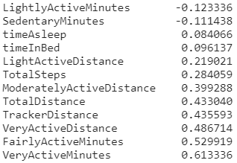
Findings
Very active minutes had the highest correlation and was the best indicator of caloric output.

Slide 6
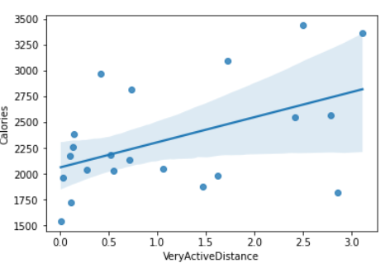
Findings
As very active distance increases the calories exerted also increase

Slide 7
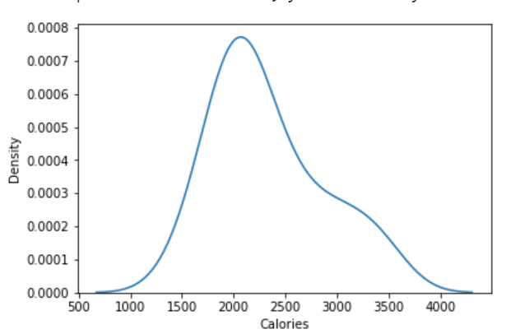
Findings
Most users use 2330 calories per day
The minimum number of calories is 1540 while the maximum is 3430
Using linear regression we find that very active minutes and total distance are statistically significant

Slide 8
Recommendations
Based on the tests above, it appears that we can accept the null hypothesis that activity has an impact on caloric output
The company can use this data to improve their app and fitbit tracker by implementing programs that reward high intensity workouts.
Adding a feature to the app that allows users to see their predicted caloric output based on intensity and duration of a planned workout would be attractive . Additionally, the app could create programs that incentivise hitting a certain number of steps for a day. With this program customers with a need for tracking a daily caloric output will be drawn to our product and increase sales.

